Slide 1

The Man Who Planted Trees
A story by Jean Giono
Woodcuts by Michael McCurdy
Notes:
Notes for assembly
Introduce yourself and the assembly. For example:
My name is Karen Letten and I work for the Woodland Trust. We look after trees and woods here in the UK, and we plant new trees for the future.
I’m going to tell you a story. You need to listen carefully and I’ll ask you some questions at the end.
(The pictures in this story are woodcuts. Woodcuts are a type of art print. Artists carve pictures or patterns onto a piece of wood, then cover it in ink and press it onto paper or cloth to create the print.)

Slide 2
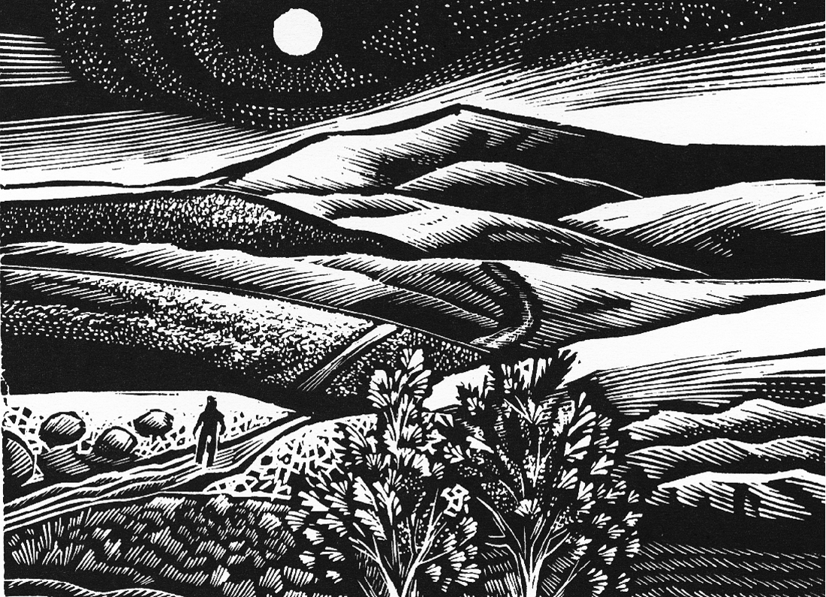
Example background page
The Man Who Planted Trees
Notes:
Slide 2
One hundred years ago there was a man called Jean-Paul who went on a long walk through the hills of southern France.

Slide 3
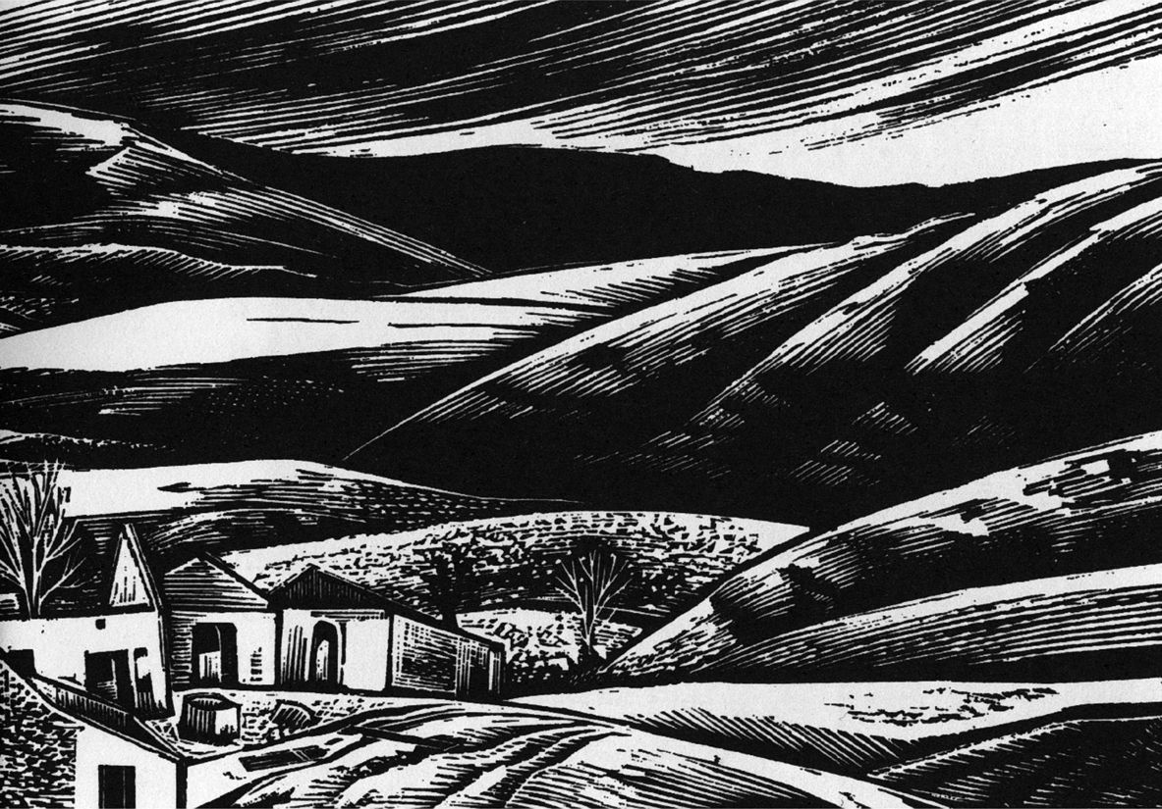
The Man Who Planted Trees
Notes:
Slide 3
The land wasn’t very green, in fact all he could see growing in these bare hills were scrubby bits of wild lavender and little else – certainly very few trees.
Tired from a long morning’s walk, Jean-Paul came to a village.

Slide 4
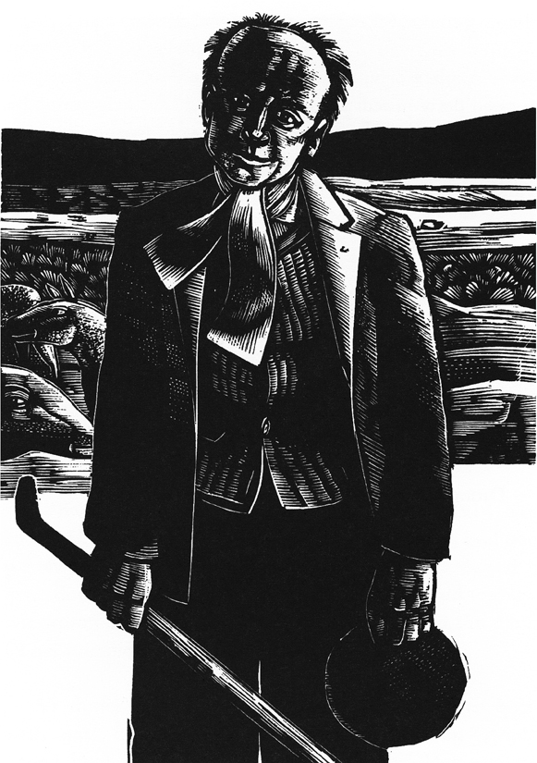
The Man Who Planted Trees
Notes:
Slide 4
Unfortunately he soon realised it was deserted, the ruined houses huddled together and silent.
There were no roofs to give protection from the cruel wind that was blowing, no trees to shade him from the sun and the natural spring where the villagers used to get their water had dried up.
He’d had no water to drink since the previous day so he walked on.

Slide 5
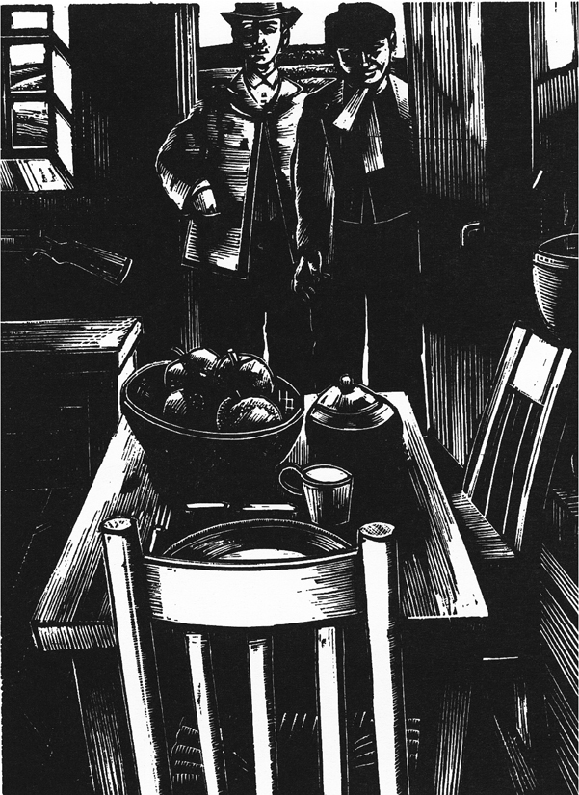
The Man Who Planted Trees
Notes:
Slide 5
After five more hours he spotted a lone shepherd looking after his sheep. The shepherd had a weather-beaten but kind face and a gentle manner.
He gave the stranger a drink from his water bottle then invited him to share some of his soup. The shepherd’s name was Elzéard (El-zay-ard).
They entered the shepherd’s stone house and Jean-Paul soon forgot the bleak and wild landscape outside. The house was clean, neat, friendly and warm. It was a safe place to rest for the night before carrying on his journey.

Slide 6
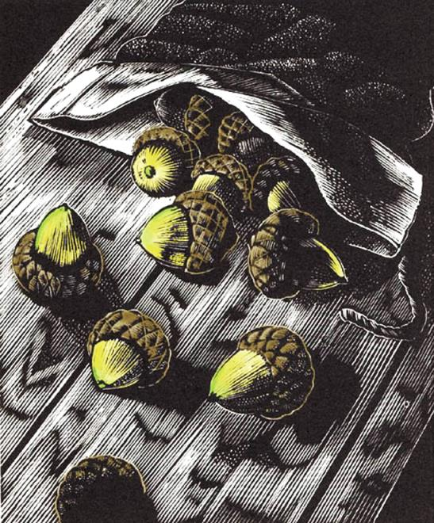
The Man Who Planted Trees
Notes:
Slide 6
After they had eaten, Elzéard fetched a little bag and emptied a pile of acorns onto the table.
Then he began carefully separating the good acorns from the bad. When he had collected a large enough pile of good acorns he divided them up into groups of 10. Once he had sorted out one hundred perfect acorns he stopped and went to bed.
The next day, after taking care of his sheep, the shepherd took the little bag of acorns and dipped it into a bucket of water then off he went. Curious to see what Elzéard was going to do with the acorns, Jean-Paul went with him.

Slide 7
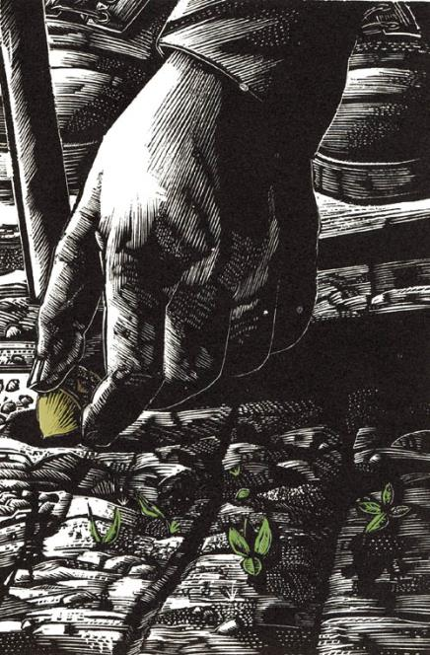
The Man Who Planted Trees
Notes:
Slide 7
Soon Elzéard began making holes in the ground. He put an acorn into each hole and covered it with soil. Jean-Paul realised the shepherd was planting oak trees. He watched as the shepherd planted all 100 acorns with great care.
Elzéard told Jean-Paul that he’d been planting trees in the wilderness for three years. And, in that time, he had planted a total of one hundred thousand acorns.
The shepherd said that when he first came to the area, he noticed that this part of the country was dying for lack of trees and, having nothing better to do, he decided to put things right.
Jean-Paul thanked the shepherd for his kindness and continued on his journey over the hills.
10 years later Jean-Paul returned to the area. Can you guess what it looked like?

Slide 8
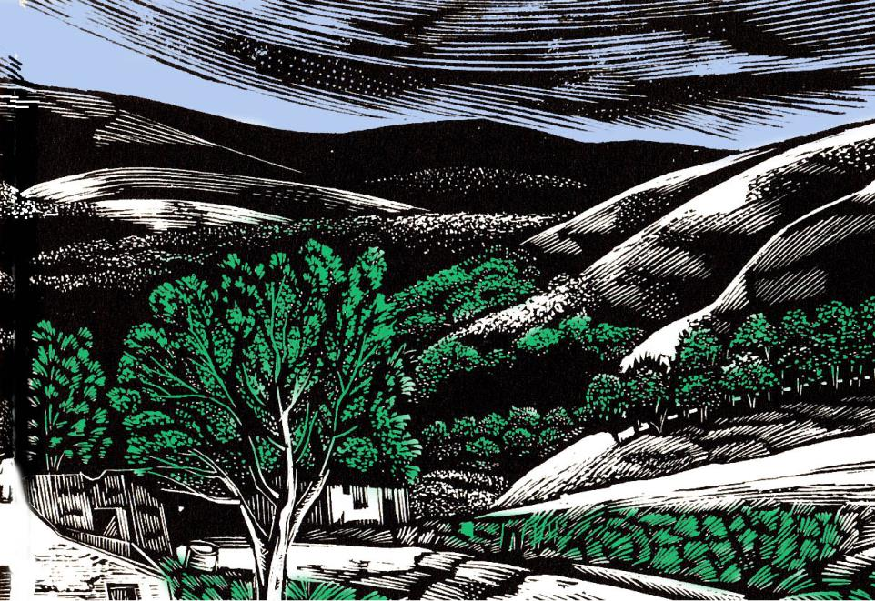
The Man Who Planted Trees
Notes:
Slide 8
This time, when he reached the deserted village Jean-Paul could see the previously barren landscape had been transformed by small trees. ‘So that is what a young forest looks like’, he said to himself.

Slide 9
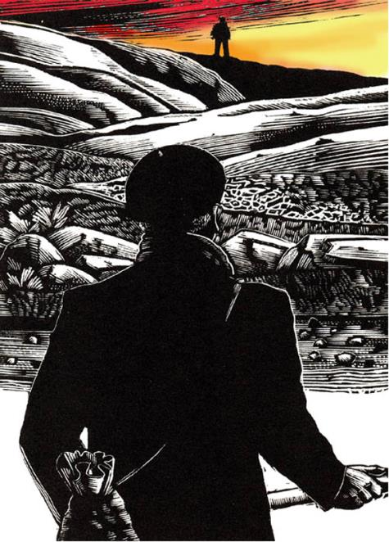
The Man Who Planted Trees
Notes:
Slide 9
He then saw the shepherd in the distance. They walked to where the carefully selected acorns had been planted all those years ago to see the young oak trees. They were taller than both of them.
Over the next few years the young trees continued to grow and grow until the area became a wonderful green forest. Families with children started returning to the area and the wildlife came back too. Instead of rough gusts of wind blowing over an empty landscape, there were soft and scented breezes, the wind in the trees sounding like running water.

Slide 10
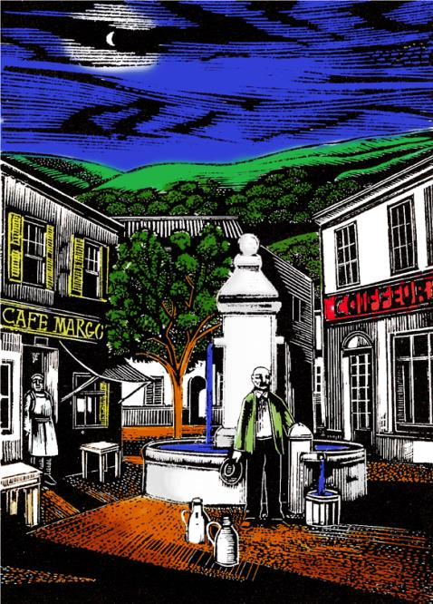
The Man Who Planted Trees
Notes:
Slide 10
Indeed water did flow once again from the springs that were previously dry and people repaired the ruined houses. Hope returned and the area grew healthy and prosperous.
All because of the Man Who Planted Trees.
Suggested questions to reinforce the message of the story:
What was the land like before the shepherd planted trees?
Why was the lack of trees a bad thing?
How did the shepherd plant trees?
What did the acorns grow into?
What happened to the village when the trees started to grow?
What sort of place would you like to live in – one with lots of trees and wildlife, or an empty place like at the start of the story?
All this was achieved through the action of just one person.
In this room there must be XXX young people. Just think how exciting it would be if we all planted trees like the shepherd.
This is exactly what the Woodland Trust is doing with children, communities and farmers all over the UK.

Slide 11
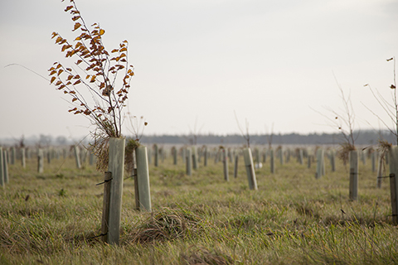
We’re planting trees to remember
the First World War
The Man Who Planted Trees
Notes:
Slide 11 – First World War Centenary Woods project
In the story, Jean-Paul went away for 10 years. During this time he fought in the First World War.
The Woodland Trust is planting trees to mark the 100th anniversary of the First World War. They are planting four special Centenary Woods, one in England, Wales, Scotland and Northern Ireland. They are also giving away three million free trees to schools, community groups and youth groups.
These symbolic trees will be planted in memory of all those who lived and died in the First World War.

Slide 12
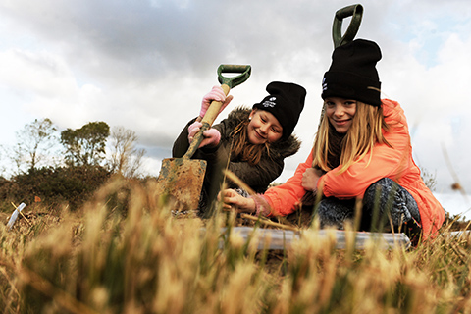
“I can’t wait to watch my tree grow.”
The Man Who Planted Trees
Notes:
Slide 12
Some lucky children will get the chance to plant trees on a Woodland Trust site and help create a new wood. These two boys had a great time planting trees…

Slide 13
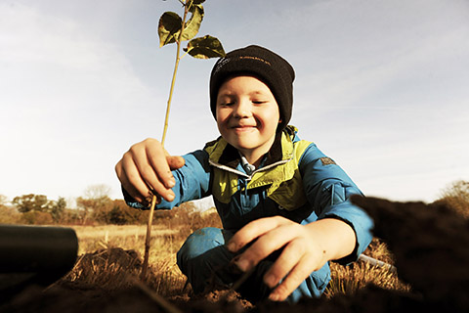
“My great-grandchildren will climb this tree one day.”
The Man Who Planted Trees
Notes:
Slide 13
…and so did these two girls, as you can see.
If you have space, ask your pupils if they’d like to apply for some free trees from the Woodland Trust to plant in your school grounds

Slide 14
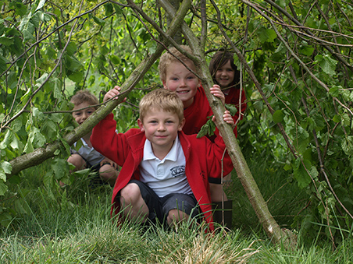
“This is much more fun
than being in a classroom”
The Man Who Planted Trees
Notes:
Slide 14
As well as planting trees, the Woodland Trust looks after 1,000 woods throughout England, Wales, Scotland and Northern Ireland. They are all free to visit and they are fun to explore on a class trip, or a picnic with your family.

Slide 15
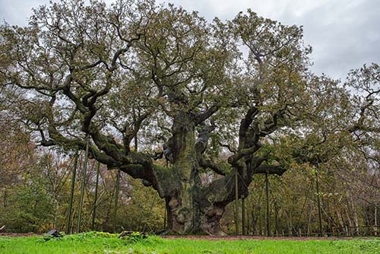
Ancient woods are special
The Man Who Planted Trees
Notes:
Slide 15
The Woodland Trust also fights to protect ancient woods from being cut down and buildings, roads, train tracks or airports being built on top of them.
Ancient woods are very, very special and important for lots of plants and animals.
In England, Wales and Northern Ireland ancient woods are really old woods that were around at the time of Queen Elizabeth I (that's 400 years ago!). In Scotland they are woods that can be traced back to 1750 (that's over 260 years ago!).
The secret is their special soils that have developed over hundreds of years. They are a unique mix of creepy crawlies, fungi, seeds and other goodies that help many plants and animals survive.
Once destroyed, these soils can never be replaced, so it’s important we look after ancient woods.

Slide 16
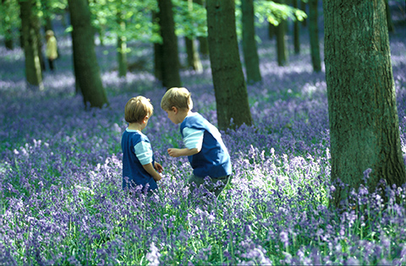
“We like finding new things we haven’t seen before”
The Man Who Planted Trees
Notes:
Slide 16
The Woodland Trust does all this because trees and woods are brilliant!
Woods are great places to spend our spare time. They change throughout the seasons providing amazing spectacles for us to enjoy, like these beautiful bluebells.

Slide 17
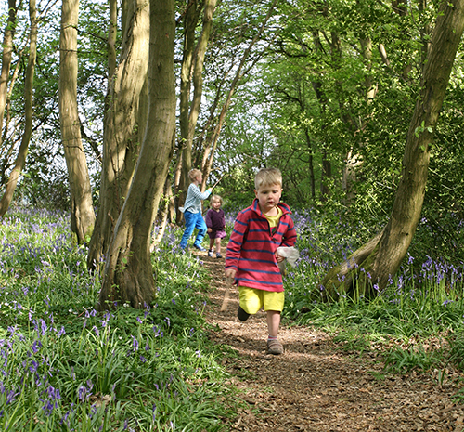
“I love exploring!”
The Man Who Planted Trees
Notes:
Slide 17
Woods are fun to explore and are good places to exercise.

Slide 18
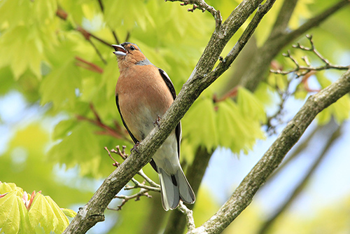
Woods are
important
for wildlife
The Man Who Planted Trees
Notes:
Slide 18
Trees and woods are also fantastic for wildlife. They provide shelter, shade, habitats and food. Do you know any animals that live in woods?

Slide 19
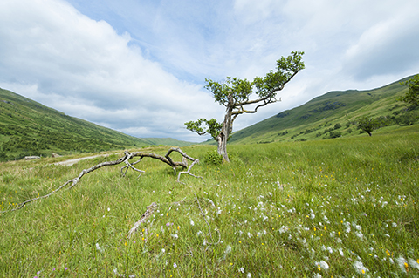
Trees make oxygen, and clean our air
The Man Who Planted Trees
Notes:
Slide 19
Woods and trees clean our air, absorbing carbon dioxide and producing oxygen.

Slide 20
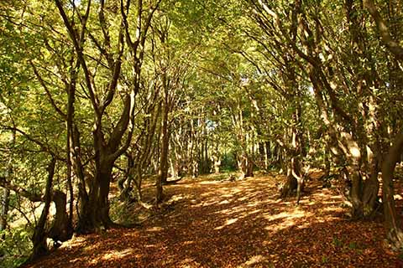
Trees provide shade
The Man Who Planted Trees
Notes:
Slide 20
Woods and trees provide shade from the sun. They also soak up sunlight and cool the air through their leaves. This helps cool the planet and reduces the effects of climate change.

Slide 21
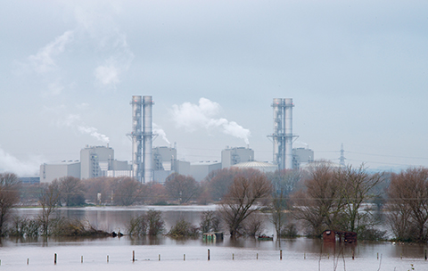
Trees help reduce the
impact of flooding
The Man Who Planted Trees
Notes:
Slide 21
Trees and woods drink up water through their roots. They help to reduce the impact of flooding by acting as water reservoirs and stabilising soil. They can also delay and slow down the flow of water.

Slide 22
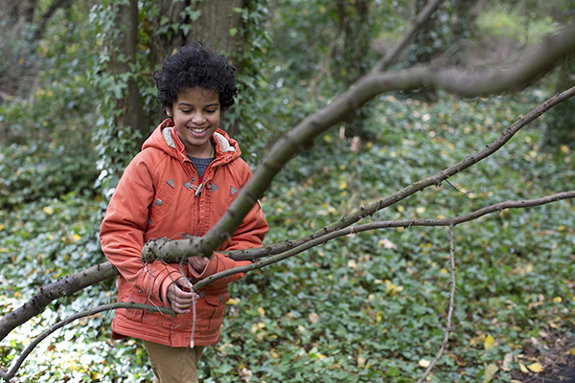
Wood is used for everything
from pencils to playgrounds
The Man Who Planted Trees
Notes:
Slide 22
Trees also provide us with timber and wood products. Can you think of anything we use wood for, or objects that are made from wood?

Slide 23
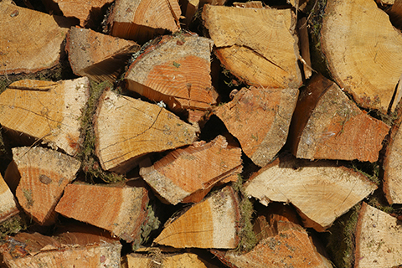
Wood is an environmentally friendly fuel
The Man Who Planted Trees
Notes:
Slide 23
Trees can provide a source of renewable fuel.
Note for older children – this fuel source does not release or take up carbon dioxide. It is carbon neutral.

Slide 24
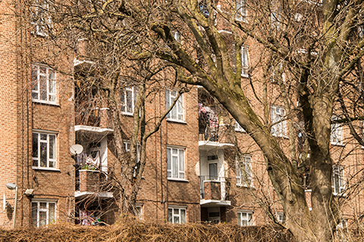
Trees are important in towns and cities too.
The Man Who Planted Trees
Notes:
Slide 24
Woods and trees don’t just belong out in the countryside, they are vitally important to people in towns and cities too. They absorb air and noise pollution, and their shade helps keep urban areas cooler.

Slide 25
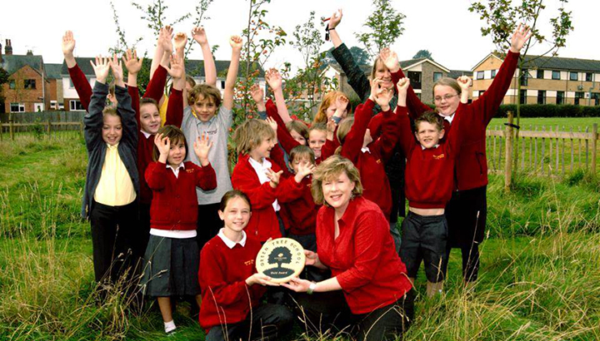
Green Tree School Award
The Man Who Planted Trees
Notes:
Slide 25 – Green Tree Schools Award
If your school is already on our Green Tree Schools Award:
Our school is registered on the Woodland Trust’s Green Tree Schools Award and we get points for doing activities that celebrate woods and trees.
We’re currently at [bronze/silver/gold/platinum] level and have collected points for [planting trees, visiting a wood, recycling…].
If you’ve reached gold level and received a plaque: We’ve also received a special wooden plaque which you can see [at the school’s entrance, at reception, outside the head teacher’s office…].
There are more projects we can do to gain extra points, such as [becoming a Woodland Ambassador and inspiring others about trees, and sharing our woodland adventures].Hands up if you’re excited about doing them.
See what activities you can do next at woodlandtrust.org.uk/schools
If your school isn’t yet registered with our Green Tree Schools Award.
The Woodland Trust runs the Green Tree Schools Award Scheme where schools can earn points for doing environmental activities that celebrate woods and trees.
More than 6,400 schools are already on the award and doing fun things like planting trees and exploring woods. Hands up if you think our school should join the award.
Find out more about the Green Tree Schools Award, how to register and the free activities you can do at woodlandtrust.org.uk/schools

Slide 26
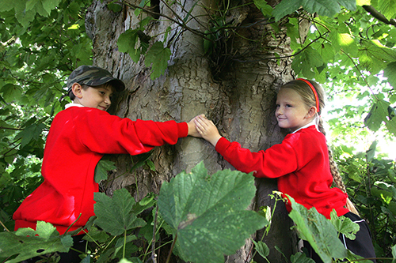
Life’s better with trees
The Man Who Planted Trees
Notes:
Slide 26
Discussion / questions / summing up
1. Why do you think trees and woods are good?
2. What can we all do to help trees?
3. Whose responsibility is it to look after the environment?
EVERYONE’S!

Slide 27
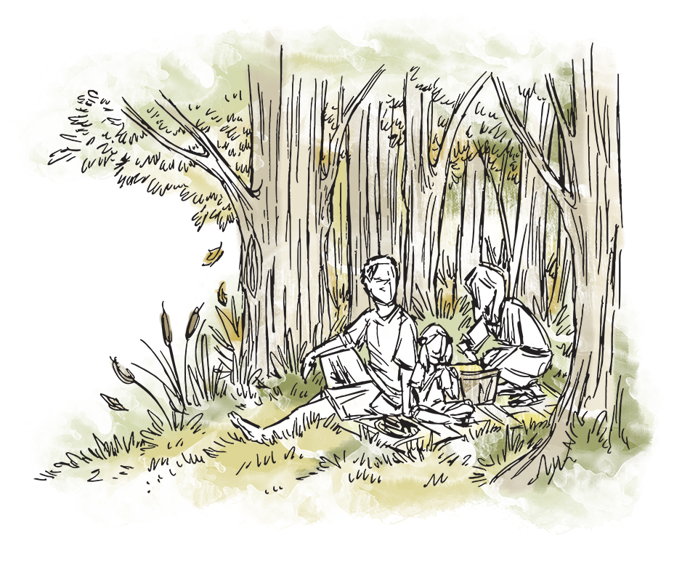

Why are trees important to you?
Do you have a tree memory you can tell us about?
Add your voice to the Tree Charter!
The Man Who Planted Trees

Slide 28
Thank you
for listening
Not heard enough?
I can tell you more
Name XXXXX, Tel XXXXX

