Slide 1
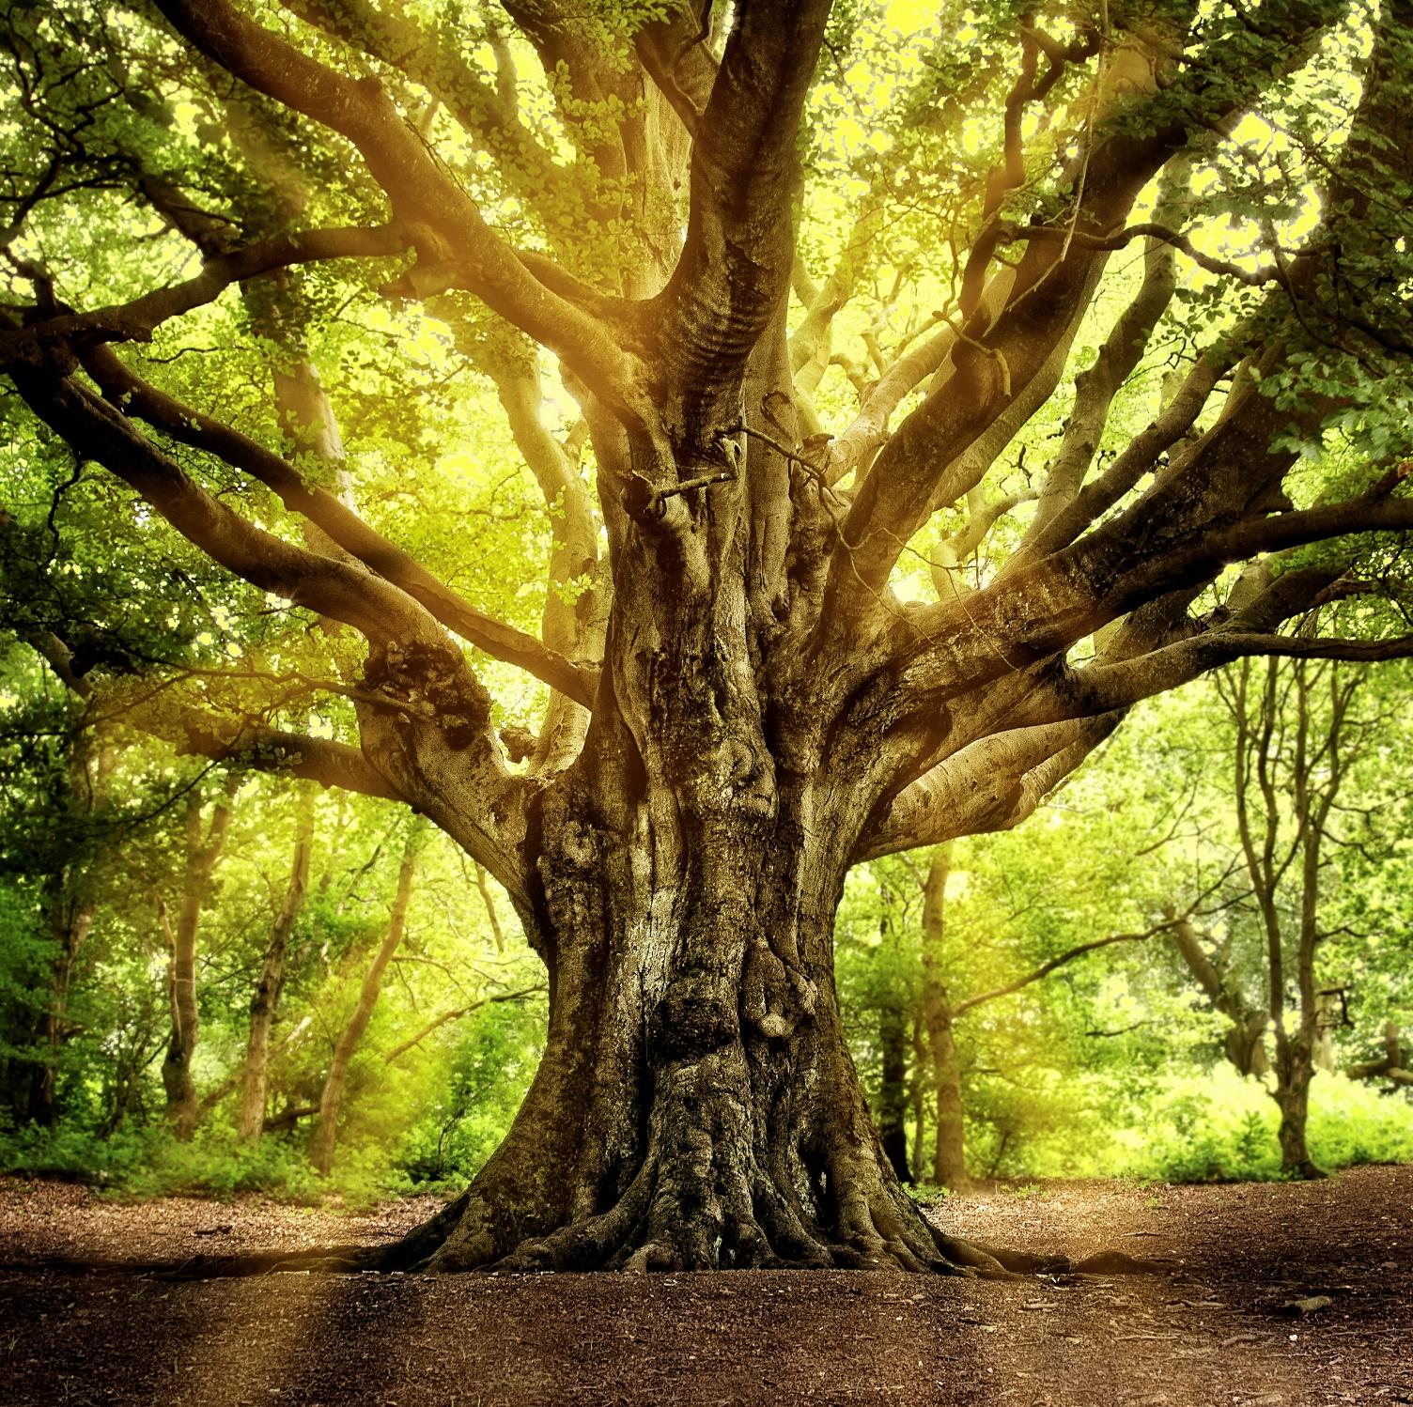
The
Power of Trees
Notes:
Today, we’re going to find out about the mighty power of trees with this assembly from the Woodland Trust – the UK’s largest woodland conservation charity.

Slide 2


Why do we need trees?
Notes:
*Question to students*
To start, I’d like you all to think about why we need trees. What’s so good about them and what benefits do they provide? Would anyone like to share any ideas?

Slide 3

Trees fight climate change
A single tree can absorb 900kg of CO₂ over its life – that’s the weight of a small car!
Notes:
Let’s look at some of the benefits trees provide, starting with climate change.
The Earth is getting hotter and it’s not just the ice caps that are melting – we’ve seen record-breaking temperatures right here in the UK topping 40C for the first time ever in 2022. Scientists agree that human activity is making this happen. Burning fossil fuels has released dangerous levels of CO₂, trapping heat in our atmosphere and causing the planet to warm up.
To slow the rate of climate change, we need to make big changes to how we work and live to cut our CO₂ emissions. But trees can also have a big impact. Trees absorb CO₂ from the atmosphere during photosynthesis – their energy-making process – and lock it up in their trunks, roots and leaves. A single tree can absorb 900kg of CO₂ over its life – that’s the weight of a small car!

Slide 4

How trees capture and store carbon
Notes:
Let’s delve into the science with this short video on photosynthesis, showing how trees capture and store carbon.
*Play video – you may need to click the ‘enable content’ button in the yellow security bar first.*
*Question to students*
So, now we understand how trees remove CO₂ from the atmosphere, do you think it’s a good idea to plant more of them to help slow climate change?

Slide 5
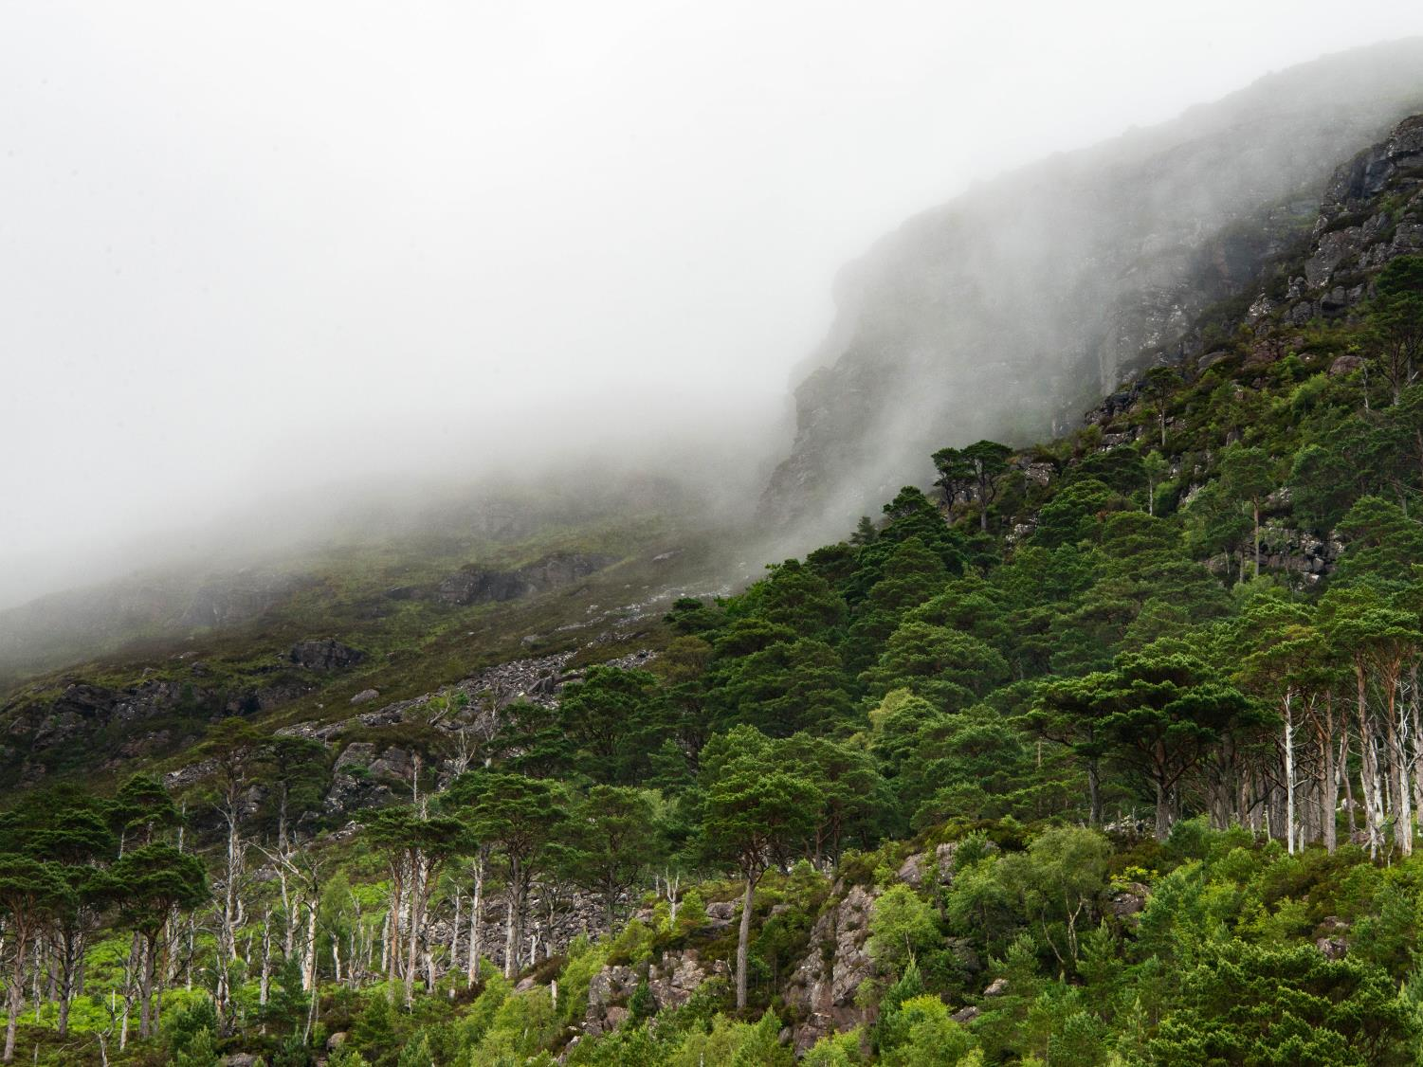
Trees clean our air
Every year, a large oak tree releases enough oxygen to
sustain one human for a year.
Notes:
As well as guzzling up CO₂, trees improve our air quality. They remove harmful pollutants from the atmosphere and release oxygen. This gives us clean air to breathe and helps prevent heart and lung diseases, such as asthma. Scientists have discovered that one large oak tree produces enough oxygen in a year to keep a human breathing for a whole year.
Urban trees are particularly important because they help to reduce high levels of air pollution in towns and cities, caused by built-up areas and lots of traffic.

Slide 6

Trees keep us cool
On a hot day, shady woods can be 10C cooler than city centres.
Notes:
Think about how it feels to be outside on a hot day in the full sun. Now imagine stepping into the shade of a tree – it instantly feels cooler, doesn’t it?
In urban areas, buildings and roads absorb the sun’s heat which makes town and cities hotter. But trees help keep us cool by providing shade and reflecting the sun’s rays. On a hot day, shady woods can be 10C cooler than city centres! Trees also cool the air by releasing water through their leaves. As this water evaporates it has a cooling effect. This is called transpiration. The cooling power of trees is especially important when we’re facing rising temperatures due to climate change.

Slide 7
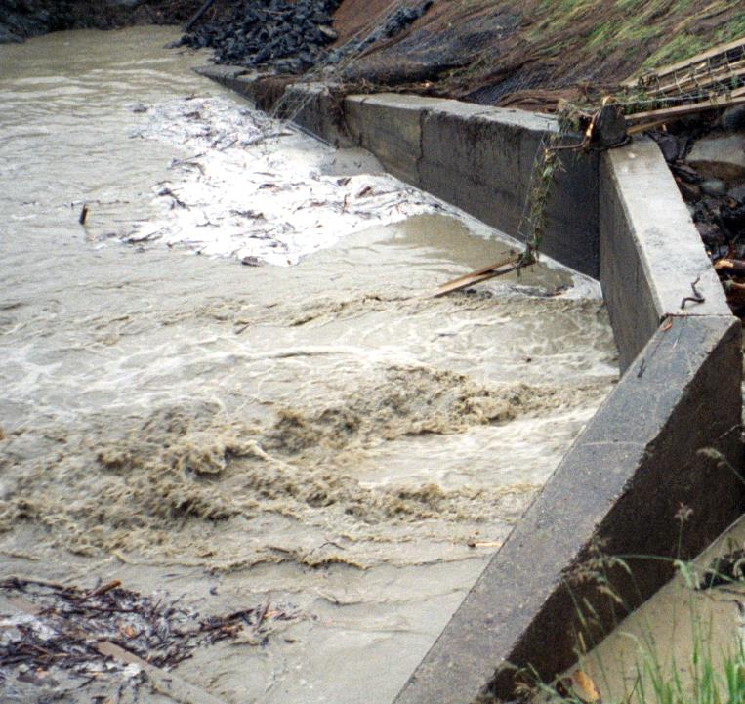
Trees reduce flooding
A mature tree can drink up to 450 litres of water in a single day - that's more than two bathtubs!
Notes:
Climate change is triggering more unpredictable and extreme weather, but it’s not just heatwaves that are the problem. Here in the UK, we’re seeing more floods caused by big storms and heavy rainfall.
But guess what? Trees are formidable flood fighters. Their roots suck moisture from the soil. A mature tree can drink up to 450 litres in a single day – that’s more than two bathtubs! Tree roots also stabilise riverbanks and prevent soil erosion. Tree canopies are important too. As raindrops fall, they hit leaves and branches on the way down. Some of this water gathers on the trees, while the rest continues on to the ground but much more slowly. This is particularly important during heavy rainfall because it prevents surface runoff – this is when there’s so much water it can’t be absorbed by the soil, so it flows across the ground.
This shows all the different ways trees reduce the risk of flooding.

Slide 8
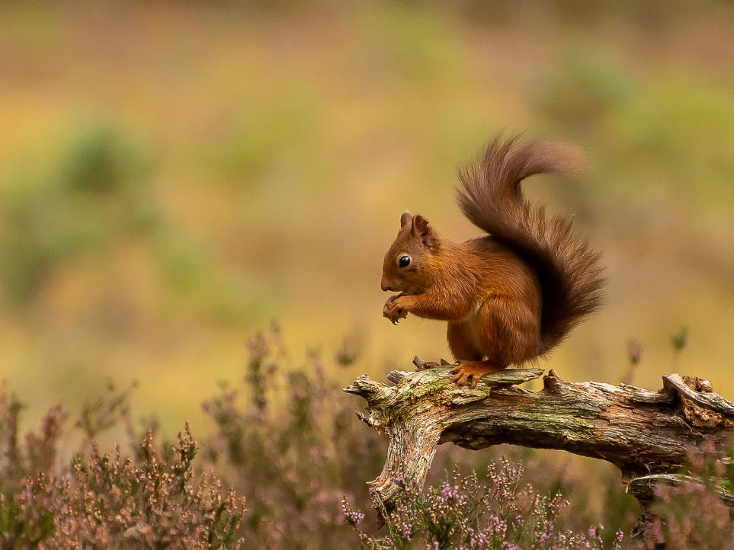
Trees and woods support wildlife
Oak trees support 2,300
species of animals,
plants and fungi.
Notes:
Trees create vital habitats for wildlife, providing the food and shelter they need to survive. Many of our best-loved species, such as red squirrels, bats, woodpeckers and stag beetles rely on trees. Different trees are important for different species, but oak trees are particularly special. They support an incredible 2,300 species of birds, mammals, invertebrates, fungi, mosses and lichens – more than any other UK tree!

Slide 9
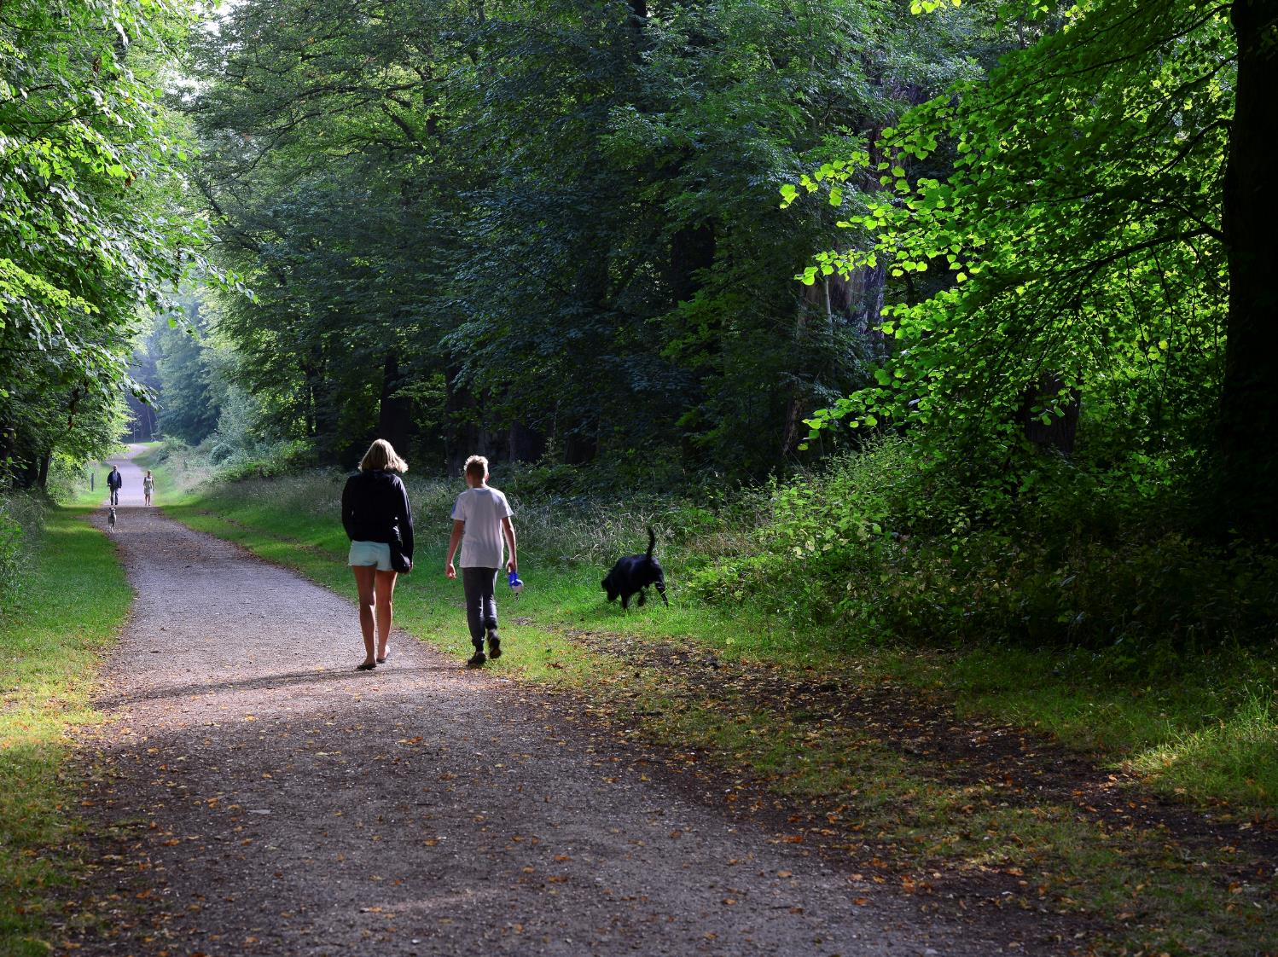
Trees boost our mental and physical health
Green spaces make us healthier
and happier.
Notes:
*Questions to students*
Hands up if you enjoy spending time outdoors. Where do you go – the woods, local park, waterways? What types of activities do you do there? How do you feel when you’re outside?
Scientific research shows that spending time outdoors is good for us. Exercise is great for maintaining our physical health, but regular exercise in woods or parks can also improve our mental health. Nature is proven to reduce stress, stabilise blood pressure and alleviate anxiety and depression. Has anyone ever been really stressed out but felt much better after going for a walk? Studies show the level of cortisol, the stress hormone, is lower when walking in nature.

Slide 10

Wood is a sustainable resource
Trees provide one of the most useful and versatile materials available.
Notes:
*Question to students*
Every day, you use items that are made from trees. Can you think of any?
Wood and paper is made from trees. It’s used for lots of purposes, including:
building materials
furniture and household items
books and magazines
pallets, crates and packaging
Wood is a renewable resource – we can plant trees to replace the ones we use. We can also recycle wood and paper into new items. However, we shouldn’t go chopping down irreplaceable habitats like rainforests or ancient woodland – this is disastrous for wildlife and fragile ecosystems. Instead, timber must be sourced in a sustainable way. There are certifications to make sure the wood we use is from sustainably managed forests. The Forest Stewardship Council’s FSC® mark is a good example. When you see it, you’ll know the product has come from a forest that is managed sustainably.

Slide 11
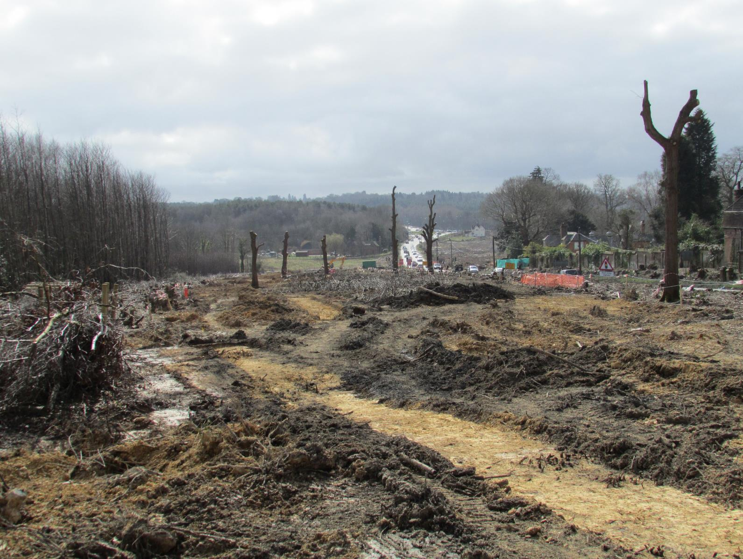
Trees and woods need our help
The Woodland Trust
protects trees and woods
from destruction and disease.
Notes:
So, we’ve discovered that trees are very powerful and they provide many benefits to us. But did you know they need our help? Trees and woods are facing increasing amounts of threats and they need protection.
*Question to students*
Can anyone think of any reasons why trees and woods would need to be protected?
Risks to trees include climate change, attacks from pests and diseases, and being chopped down to make way for roads, railways and buildings.
One of the Woodland Trust’s key areas of work is fighting to protect trees and woods from these threats. They’ve successfully stopped 1,172 woods from being destroyed and they’re campaigning to save many more right now.

Slide 12
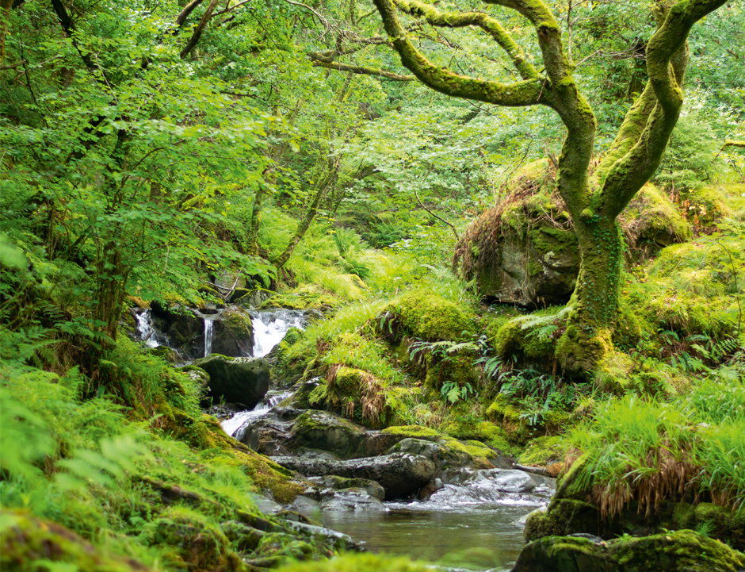
Ancient woodland is irreplaceable
Once it’s gone, it’s lost forever.
Notes:
This slide shows some ancient woodland. It’s a very old, rare and special habitat that can’t be recreated. Once it’s gone, it’s lost forever, so it’s particularly vulnerable to threats.
*Question to students*
Would anyone like to guess how old ancient woodland is?
Answer: In England, Wales and Northern Ireland, ancient woods were standing during the reign of Queen Elizabeth I – 400 years ago! In Scotland, ancient woods that can be traced back to 1750 – over 260 years ago.
Our oldest woods are important because of their special soils that have developed over hundreds of years. They are made up of a unique mix of invertebrates, fungi and seeds that help many plants and animals survive. Once destroyed, these soils can never be replaced, so it’s crucial we protect ancient woods and stop any further loss. That’s exactly what the Woodland Trust fights for.

Slide 13
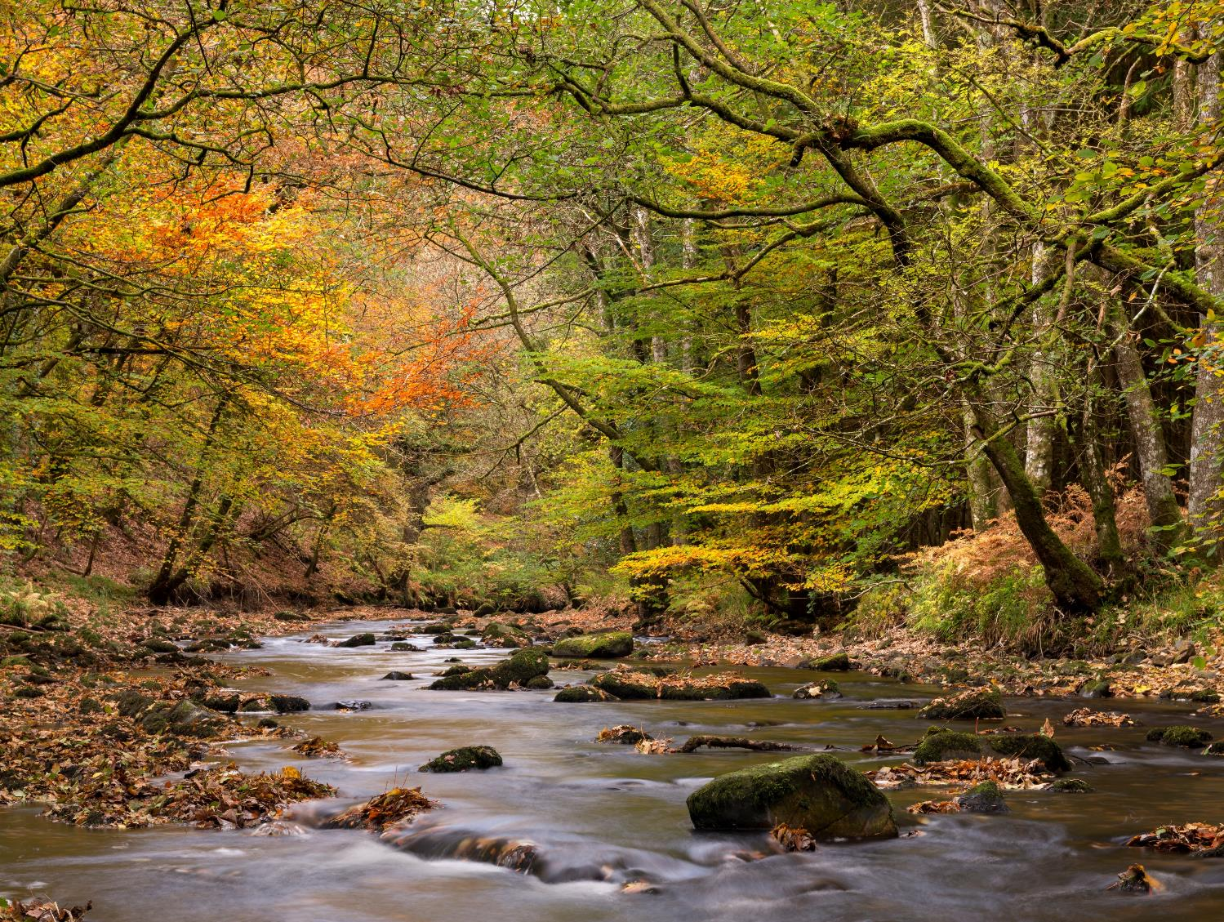
Bringing damaged woods back to life
The Woodland Trust restores
ancient woodland.
Notes:
The Woodland Trust also restores damaged ancient woodland. Often, these irreplaceable sites have been replanted with fast-growing conifers for timber. As conifers don’t support as much wildlife as our native oak, birch and hazel trees, this has terrible consequences for wildlife. However, with careful restoration work these precious habitats can be brought back to life and plants and animals can thrive once again.

Slide 14
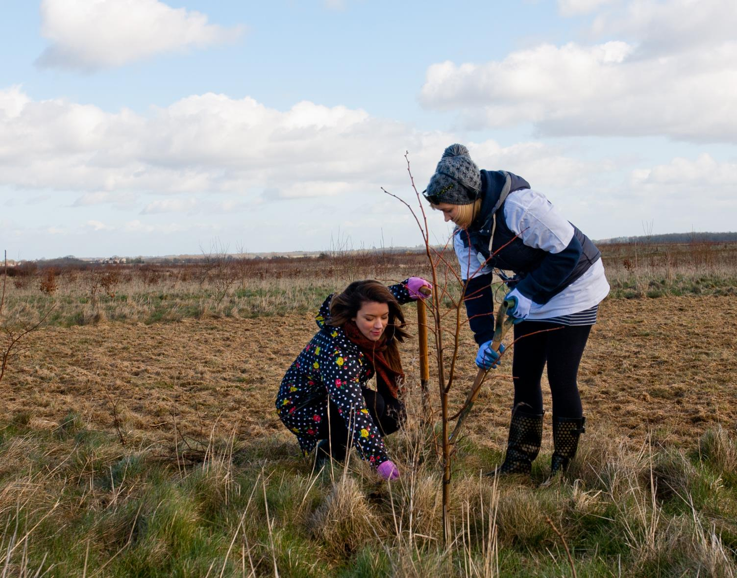
55 million trees…and counting!
The Woodland Trust plants
trees to combat climate
change and build a greener
future for the UK.
Notes:
*Question to students*
Hands up if you’ve ever planted a tree.
The Woodland Trust has planted a staggering 55 million trees with schools, communities and landowners! They have ambitious aims to plant many millions more too. These trees are havens for wildlife and provide vital green spaces for people, as well as all the other amazing things trees do which we’ve discussed today.

Slide 15
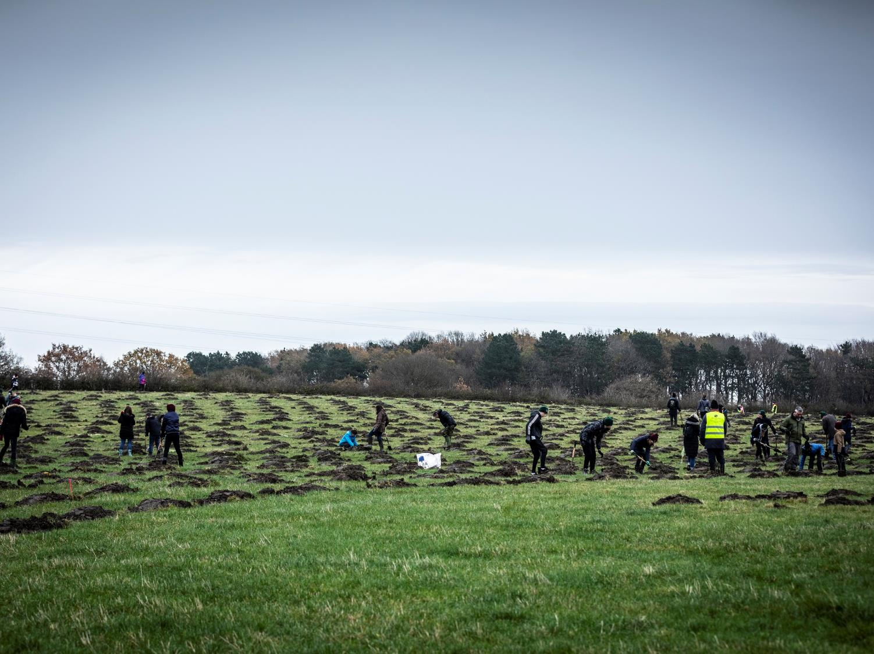
Young People’s Forest
The UK’s first forest created by and for young people.
Mead
Notes:
This is the Young People’s Forest, a Woodland Trust site in Derbyshire. Children and young people have planted 250,000 trees here which are growing into a flourishing woodland. Young people are also involved in decision making and shaping the future of this wood, creating a thriving green space that benefits youngsters as well as the wider community. So far, they’ve organised successful festivals, a colour run and outdoor yoga sessions, with lots more exciting initiatives to come.

Slide 16
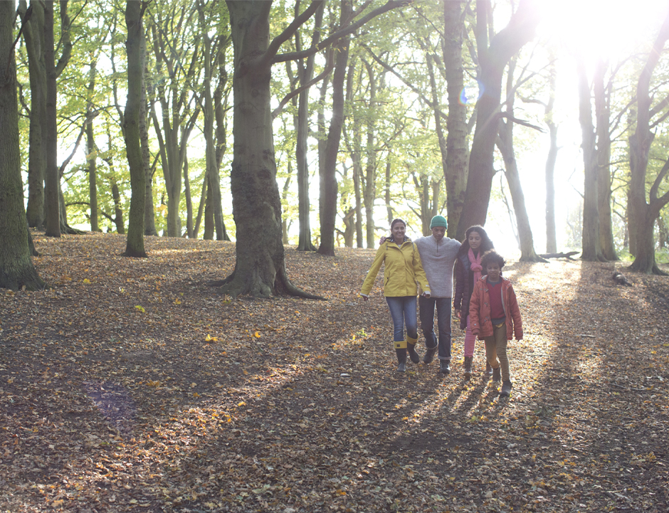
Over 1,000 woods across the UK
Free for everyone to visit and enjoy.
Notes:
The Woodland Trust owns and cares for 1,000 woods across the UK. They believe everyone deserves to enjoy trees and woods, so these sites are free to visit and explore. They’re ideal for family walks, picnics, or school field trips.

Slide 17

How you can get involved
The Woodland Trust has over 13,000 schools registered
on its Green Tree Schools Award.
woodlandtrust.org.uk/award
Notes:
It’s not just down to organisations like the Woodland Trust to protect trees and woods. Trees benefit everyone, so we all need to take responsibility and do our bit. The Woodland Trust encourages young people to take action for the environment with their Green Tree Schools Award.
Students take part in fun, practical projects that improve school grounds and benefit the local community, while raising awareness of the importance of trees and woods. There are lots of opportunities for outdoor learning, and you can earn certificates in recognition of your achievements and a special plaque to display in your school.
*Question to students*
Who would like to get together as a class/year group/eco club and discuss which projects you’d like to tackle? We can find out more online: woodlandtrust.org.uk/award.

Slide 18
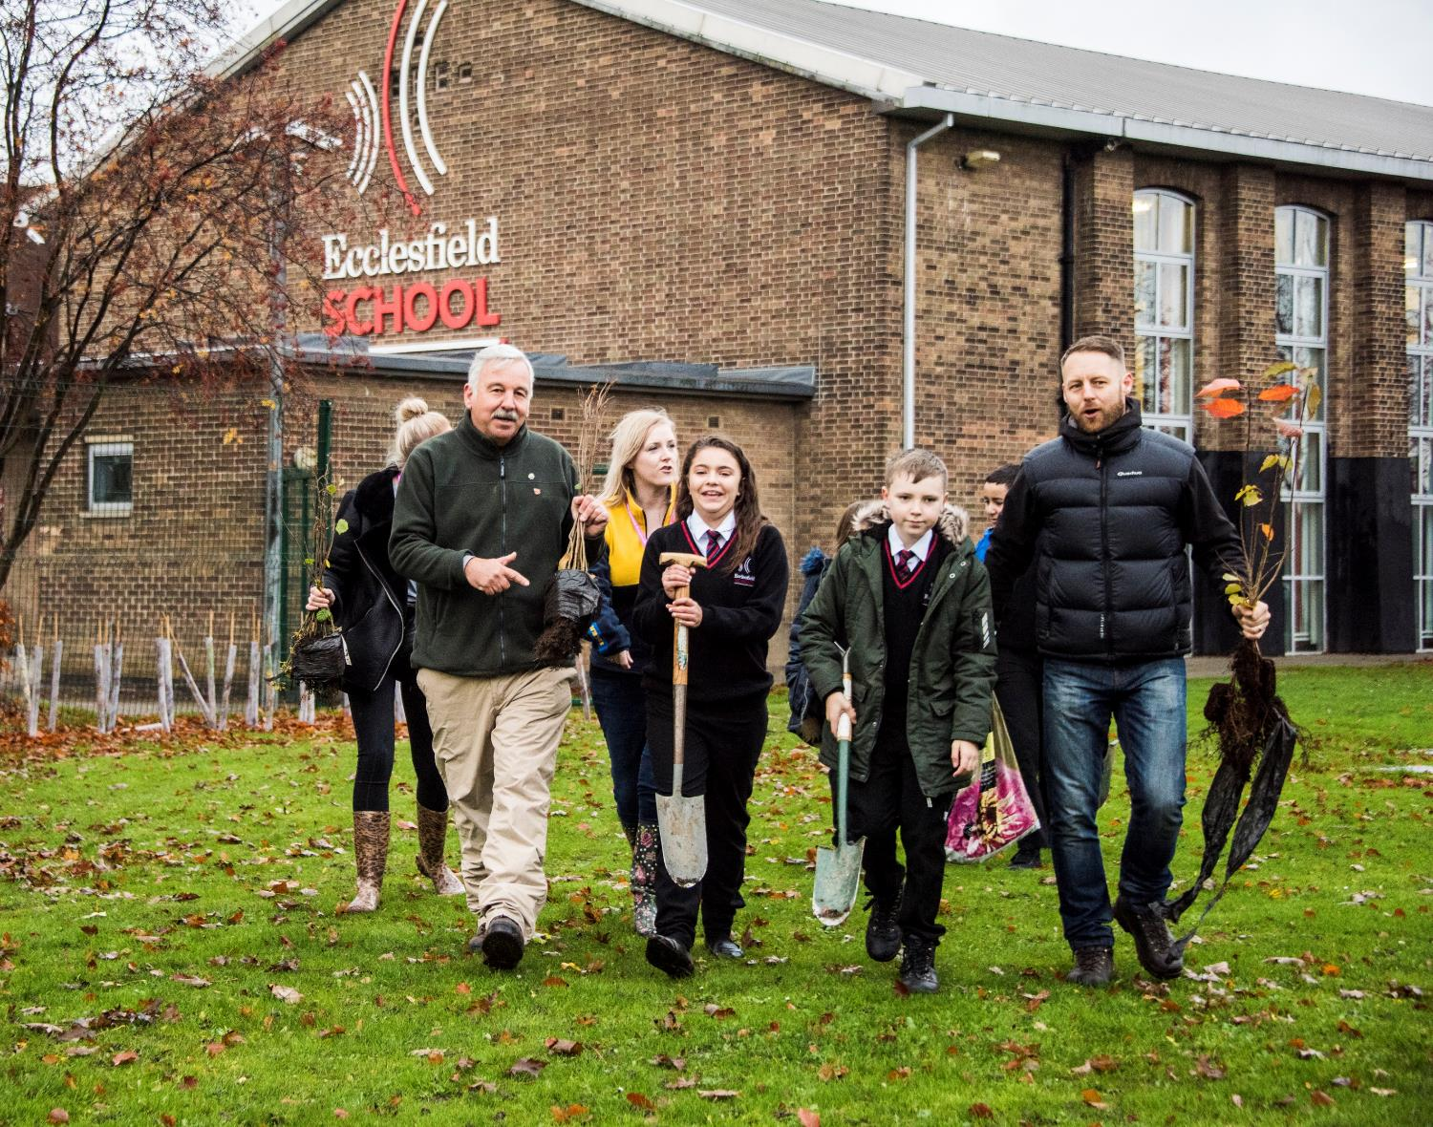
Dig in!
Plant trees with your school or community.
Notes:
Planting trees is one of the challenges on the Green Tree Schools Award. It’s a truly memorable experience, and whether you plant trees to grow an outdoor classroom, create homes for wildlife or fight climate change, you’ll be making a real difference. The Woodland Trust has given away millions of trees to schools to plant in their grounds and green their communities.
*Questions to students*
Is this something our school could do? Do we have space to plant trees at our school or on some local public land? Hands up if you’d think we should apply for a pack of free trees from the Woodland Trust.

Slide 19
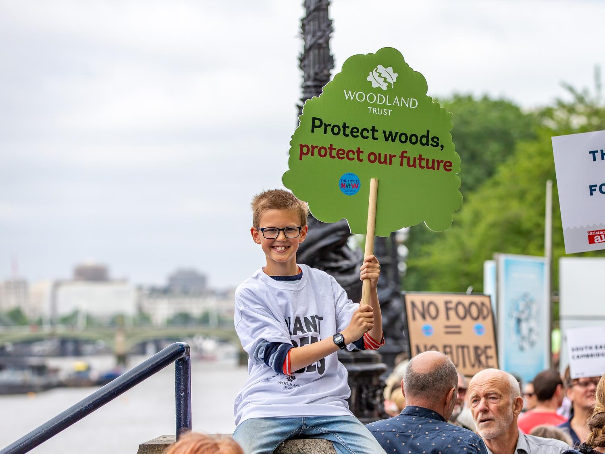
Use your voice for change
Start a campaign
for trees and woods.
Notes:
Young people like yourselves have powerful voices and can make a real difference to the future of our environment.
This Green Tree Schools Award challenge involves starting an environmental campaign that encourages others to act and make a positive change for trees and woods. This activity helps you learn about campaigning and how to use your voice to make an impact.
You could start a campaign to save a local green space, urge your local council to expand tree cover in your area or encourage action on climate change.
*Question to students*
Does anyone have any ideas for an environmental campaign we could start in our school?

Slide 20
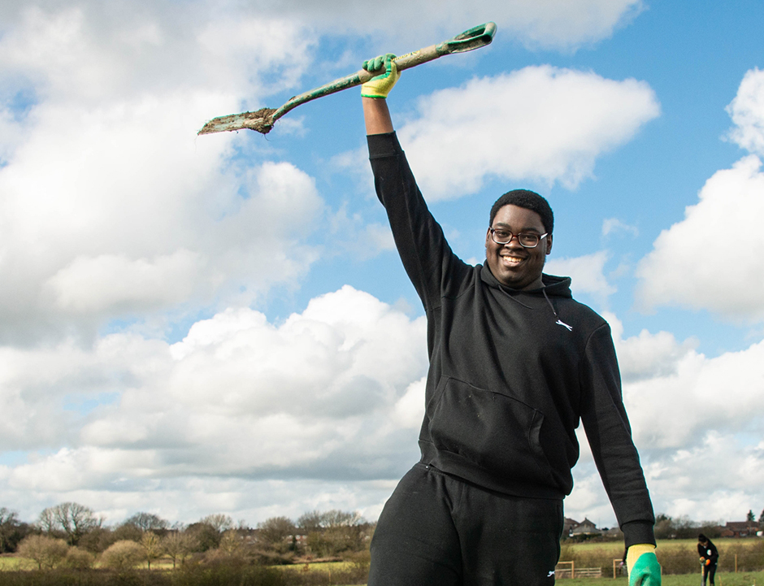

How will YOU take
action for trees?
Get involved at
woodlandtrust.org.uk
Notes:
I hope you’ve enjoyed learning about trees, all the incredible benefits they provide to people and the planet, and why it’s important we all do our bit to protect them. If you’d like to find out more, you can visit the Woodland Trust’s website which has lots of information about trees, climate change and the Green Tree Schools Award: woodlandtrust.org.uk.
*Questions to students*
Who is inspired to take action for trees today? How will you make a difference?

